Slide 1
OOP152 – OBJECT-ORIENTED PROGRAMMING
2024

Slide 2
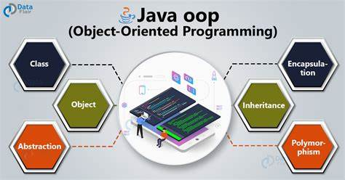
Object-oriented programming (oop152)

Slide 3
Access: Books / Eclipse ide / MS office…etc.

Slide 4
PRESCRIBED Textbook
Think Java: How to Think Like a Computer Scientist Downey, A.B. and Mayfield, C. (2019) Version 6.1.3

Slide 5
Topic 2 More complex methods

Slide 6
methods
OUTCOMES
Value Methods
Recursive Methods

Slide 7
methods
OUTLINE
Value Methods
Return Values
Writing Methods
Method Composition
Overloading
Boolean Methods
Javadoc tags
More Recursive
Leap of Faith
Examples

Slide 8
Return values

Slide 9
methods
Return values:
Void Methods
Invocation on its own line
Example: countup(3);
Main characteristics:
Does not return a value.
Typically performs an action such as printing output or modifying data.

Slide 10
methods
Return values:
Void Methods
Example Code:
public static void countup(int n) {
if (n == 0) {
System.out.println("Blastoff!");
} else {
countup(n - 1);
System.out.println(n);
}
}

Slide 11
methods
Return values:
Void Methods
Usage:
countup(3);
System.out.println("Have a nice day.");.

Slide 12
methods
Return values:
Value Methods
Requires handling the return value
Example: double error = Math.abs(expected - actual);
Main characteristics:
Declares a return type (e.g., double).
Must use at least one return statement to provide a return value.

Slide 13
methods
Return values:
Value Methods
Example Code:
public static double calculateArea(double radius) {
return Math.PI * radius * radius;
}

Slide 14
methods
Return values:
Value Methods
Advanced Usage:
Handling complex expressions directly in the return statement.
Possible to use temporary variables for clarity and easier debugging.

Slide 15
methods
Return values:
Value Methods
Special Considerations for Return Statements
Type matching:
The type of the expression in the return statement must match the declared return type.
Multiple return points:
Useful in conditional structures to return different values based on conditions.

Slide 16
methods
Return values:
Value Methods
Example Code – Multiple return points:
public static double absoluteValue(double x) {
if (x < 0) {
return -x;
} else {
return x;
}
// Unreachable code below
// System.out.println("This line is dead.");
}

Slide 17
methods
Return values:
Value Methods
Handling all paths:
Ensure every possible path through the method reaches a return statement to avoid compilation errors.

Slide 18
methods
Return values:
Value Methods
Example Code (Incorrect):
public static double absoluteValue(double x) {
if (x < 0) {
return -x;
} else if (x > 0) {
return x;
}
// Missing return statement when x is 0
}

Slide 19
methods
Return values:
Conclusion
Understanding void and value methods is crucial for writing correct Java programs.
Proper use of return statements is essential to control method outcomes and avoid compilation errors.

Slide 20
writing methods

Slide 21
methods
Writing Methods:
Incremental Development in Programming
Start Small:
Begin with a working program.
Make small, incremental changes.
If errors occur, they are easier to pinpoint.
Use of Variables:
Utilize variables to hold intermediate values.
Check these values with print statements or a debugger to ensure correctness.

Slide 22
methods
Writing Methods:
Incremental Development in Programming
Consolidate Carefully:
Once the program works, combine multiple statements into compound expressions if it improves readability.

Slide 23
methods
Writing Methods:
Incremental Development in Programming
Example: Calculating Distance Between Two Points
Consider inputs and outputs; use double values for coordinates.
Implement a method stub first to ensure syntax is correct.
public static double distance(double x1, double y1, double x2, double y2) {
return 0.0; // Stub: Compiles but does not perform calculation
}

Slide 24
methods
Writing Methods:
Incremental Development in Programming
Testing Early:
Test the stub with known values to prepare for full implementation..
double dist = distance(1.0, 2.0, 4.0, 6.0); // Should calculate the hypotenuse of a 3-4-5 triangle

Slide 25
methods
Writing Methods:
Incremental Development in Programming
Develop Method Incrementally:
Add one piece of functionality at a time.
Compile and test after each change.

Slide 26
methods
Writing Methods:
Incremental Development in Programming
Develop Method Incrementally:
// First, calculate differences
public static double distance(double x1, double y1, double x2, double y2) {
double dx = x2 - x1;
double dy = y2 - y1;
System.out.println("dx is " + dx); // Intermediate check
System.out.println("dy is " + dy); // Intermediate check
return 0.0;
}

Slide 27
methods
Writing Methods:
Incremental Development in Programming
Develop Method Incrementally:
Proceed to calculate squares of differences:
public static double distance(double x1, double y1, double x2, double y2) {
double dx = x2 - x1;
double dy = y2 - y1;
double dsquared = dx * dx + dy * dy;
System.out.println("dsquared is " + dsquared); // Check intermediate squared distance
return 0.0;
}

Slide 28
methods
Writing Methods:
Incremental Development in Programming
Develop Method Incrementally:
Finally, calculate the square root to find the distance:
public static double distance(double x1, double y1, double x2, double y2) {
double dx = x2 - x1;
double dy = y2 - y1;
double dsquared = dx * dx + dy * dy;
double result = Math.sqrt(dsquared); // Compute final result
return result;
}

Slide 29
methods
Writing Methods:
Incremental Development in Programming
Remove Scaffolding:
Once confirmed working, remove print statements.
Final code should be clean and efficient.
Benefits of Incremental Development:
Minimizes the complexity of debugging.
Increases the accuracy of each code segment.
Helps in building complex systems more reliably.

Slide 30
Method composition

Slide 31
methods
Method Composition
Method Composition
Overview: Method composition involves using existing methods to build new functionality, simplifying complex computations into manageable parts.
Example Scenario
Problem: Calculate the area of a circle given the centre point (xc, yc) and a perimeter point (xp, yp).

Slide 32
methods
Method Composition
Steps and Code Examples:
Calculate Radius:
Find the distance between the centre and perimeter points.
Use the distance method:
double radius = distance(xc, yc, xp, yp);

Slide 33
methods
Method Composition
Steps and Code Examples:
Calculate Area:
Compute the area of the circle using the radius.
Use the calculateArea method:
double area = calculateArea(radius);
public static double calculateArea(double r) {
double result = Math.PI * r * r;
return result;
}

Slide 34
methods
Method Composition
Steps and Code Examples:
Combine Methods:
Create a new method to calculate circle area by combining the above steps.
Initial verbose method:
public static double circleArea(double xc, double yc, double xp, double yp) {
double radius = distance(xc, yc, xp, yp);
double area = calculateArea(radius);
return area;
}

Slide 35
methods
Method Composition
Steps and Code Examples:
Combine Methods:
More concise method after ensuring correctness:
public static double circleArea(double xc, double yc, double xp, double yp) {
return calculateArea(distance(xc, yc, xp, yp));
}

Slide 36
methods
Method Composition
Concept of Functional Decomposition:
Definition: Breaking a complex computation into simpler, testable methods.
Benefits:
Easier debugging.
More maintainable and correct code.

Slide 37
overloading

Slide 38
methods
Overloading
Introduction to Overloading
Overloading allows multiple methods to have the same name within the same class but with different parameters.
Useful for methods performing similar operations with different types or numbers of inputs.

Slide 39
methods
Overloading
Example of Overloading
Consider two methods for calculating the area of a circle, calculateArea:
Method that takes a single radius.
Method that takes coordinates of the circle’s centre and a point on the perimeter.

Slide 40
methods
Overloading
Example of Overloading
Code Example:
// Method to calculate area with radius
public static double calculateArea(double radius) {
return Math.PI * radius * radius;
}
// Overloaded method to calculate area with coordinates
public static double calculateArea(double xc, double yc, double xp, double yp) {
return calculateArea(distance(xc, yc, xp, yp));
}

Slide 41
methods
Overloading
How Overloading Works
Java distinguishes which method to call based on the provided arguments.
Example:
calculateArea(3.0); calls the method with one double argument (radius).
calculateArea(1.0, 2.0, 4.0, 6.0); calls the method with four double arguments (coordinates).

Slide 42
methods
Overloading
Usage in Java Standard Library
Many standard methods are overloaded.
For example, System.out.println and Math.abs have multiple overloaded forms to handle different data types.
Caution When Using Overloading
Although useful, overloading can lead to confusion if not used carefully.
It's important to clearly understand which method version is being called in your code to avoid debugging issues.

Slide 43
Boolean methods

Slide 44
methods
Boolean Methods
Introduction to Boolean Methods:
Methods can return boolean values to encapsulate conditions.
Useful for simplifying and organizing tests or conditions within code.

Slide 45
methods
Boolean Methods
Example of a Boolean Method:
Method to check if a number is a single-digit
public static boolean isSingleDigit(int x) {
return x > -10 && x < 10;
}
Simplifies the test by directly returning the result of a boolean expression.

Slide 46
Methods
Boolean Methods
Naming Conventions:
Boolean methods typically named as yes/no questions, e.g., isSingleDigit.
Helps clarify the purpose and return type of the method.

Slide 47
Methods
Boolean Methods
Using Boolean Methods in Code:
Example of invoking the boolean method
System.out.println(isSingleDigit(2)); // Outputs: true
boolean bigFlag = !isSingleDigit(17); // bigFlag is set to true
The method simplifies checks and enhances readability.

Slide 48
Methods
Boolean Methods
Conditional Usage:
Boolean methods are often used in conditional statements
if (isSingleDigit(z)) {
System.out.println("z is small");
} else {
System.out.println("z is big");
}
This structure allows conditions to read almost like natural language.

Slide 49
Javadoc tags

Slide 50
methods
Javadoc Tags
Introduction to Javadoc Tags
Documentation comments are crucial for understanding classes and methods without reading the code.
Uses /** to start documentation comments.
Using Javadoc Tags
Javadoc tags, starting with @, help organize documentation into sections.
Common tags include @param and @return for additional details about methods.

Slide 51
methods
Javadoc Tags
Code Example: Documenting Parameters and Return Values
/**
* Tests whether x is a single digit integer.
*
* @param x the integer to test
* @return true if x has one digit, false otherwise
*/
public static boolean isSingleDigit(int x) {
return x > -10 && x < 10;
}

Slide 52
methods
Javadoc Tags
Details on Tags
Each method parameter should have a separate @param tag.
@return tag is used to describe the return value of methods.
Void methods should not use the @return tag since they do not return a value.

Slide 53
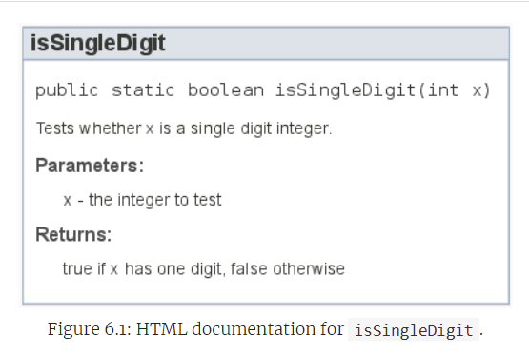
methods
Javadoc Tags
Output Example
Generated HTML documentation links the source code with formatted descriptions.

Slide 54
MORE RECURSION

Slide 55
methods
Recursion
Turing Completeness Explained:
Java is a Turing complete programming language, meaning it can compute anything that is computable.
This concept aligns with the Church-Turing thesis, named after Alonzo Church and Alan Turing.

Slide 56
methods
Recursion
What is Recursion?:
Recursive methods allow functions to call themselves, often used to solve problems that can naturally be described in terms of smaller instances of the same problem.
Circular vs. Recursive Definitions:
Unlike circular definitions, which are not useful, recursive definitions refer back to the defined item in a useful way.
Example joke about recursion: Searching for "recursion" on Google suggests "Did you mean: recursion."

Slide 57
methods
Recursion
Recursive Definition of Factorial
Factorial Function:
Mathematically, 𝑛!n! (factorial of 𝑛n) is defined as:
0!=1
n!=n×(n−1)!
Distinction:
The factorial symbol !! is different from the Java logical operator !!, which means NOT.

Slide 58
methods
Recursion
Implementing Factorial in Java
Java Method for Factorial:
Start with a simple method signature:
public static int factorial(int n) {
return 0; // Placeholder return
}

Slide 59
methods
Recursion
Implementing Factorial in Java
Base Case and Recursive Case:
Handle the base case (when 𝑛n is zero):
public static int factorial(int n) {
if (n == 0) {
return 1; // Base case: 0! is 1
}
return 0; // Placeholder for recursion
}

Slide 60
methods
Recursion
Implementing Factorial in Java
Implement the recursive case:
public static int factorial(int n) {
if (n == 0) {
return 1;
}
int recurse = factorial(n - 1); // Recursive call
int result = n * recurse; // Use the result of recursion
return result;
}

Slide 61
methods
Recursion
Execution Flow of Recursive Factorial
Understanding the Flow:
Explaining how recursion works using the factorial example, detailing each step's return process.

Slide 62
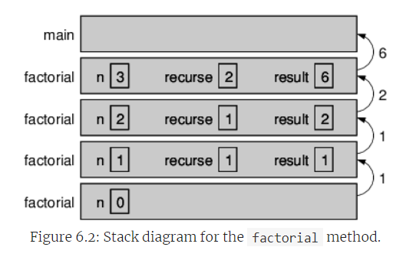
methods
Recursion
Execution Flow of Recursive Factorial
Visual Aid:
Consider showing a stack diagram (like Figure 6.2) to visualize how values are passed up the recursion stack.

Slide 63
methods
Recursion
Recursion in Programming:
Recursion is a powerful tool in programming that can simplify the code for complex problems when a recursive solution is more straightforward than iterative ones.
Practical Applications:
Besides mathematical functions, recursion is widely used in data structures like trees and graphs, as well as in algorithms such as sorting and searching.

Slide 64
More RECURSION example

Slide 65
methods
Recursion Example
Introduction to Fibonacci Sequence:
The Fibonacci sequence is a series of numbers where each number is the sum of the two preceding ones.
Typically starts with the numbers 1 and 1.
Mathematical Definition:
fibonacci(1)=1
fibonacci(2)=1
fibonacci(𝑛)=fibonacci(n)=fibonacci(n−1)+fibonacci(n−2) for 𝑛>2

Slide 66
methods
Recursion Example
Java Implementation:
public static int fibonacci(int n) {
if (n == 1 || n == 2) {
return 1;
}
return fibonacci(n - 1) + fibonacci(n - 2);
}
This function uses recursion to compute each term of the sequence.
The base cases are when 𝑛n is 1 or 2, both returning 1.

Slide 67
methods
Recursion Example
Java Implementation:
public static int fibonacci(int n) {
if (n == 1 || n == 2) {
return 1;
}
return fibonacci(n - 1) + fibonacci(n - 2);
}
This function uses recursion to compute each term of the sequence.
The base cases are when 𝑛n is 1 or 2, both returning 1.

Slide 68
methods
Recursion Example
Understanding Recursion:
Recursion involves the function calling itself with adjusted arguments.
Each call to fibonacci computes a smaller part of the sequence until reaching the base cases.

Slide 69
methods
Recursion Example
Example of Execution:
Calculating fibonacci(5):
It requires fibonacci(4) and fibonacci(3).
Continues to break down each function call into smaller calls until reaching fibonacci(1) or fibonacci(2).

Slide 70
methods
Recursion Example
Leap of Faith:
By assuming the recursive calls work as intended, the correctness of the function can be understood as the sum of two correct responses.

Slide 71
Exercises

Slide 72
methods
Exercises:
If you have a question about whether something is legal, and what happens if it is not, a good way to find out is to ask the compiler. Answer the following questions by trying them out.
What happens if you invoke a value method and don’t do anything with the result; that is, if you don’t assign it to a variable or use it as part of a larger expression?
What happens if you use a void method as part of an expression? For example, try System.out.println("boo!") + 7;

Slide 73



